Slide 1
Notes:
Welcome to our presentation on PhotonHub Europe: the digital innovation hub for photonics.

Slide 2
Notes:
Photonics is the science and technology that innovates with the unique properties of light. It is recognized by the European Commission as a key enabling and a key digital technology for the 21st century.

Slide 3
Notes:
Photonics is a fast growing industry sector driving crucial applications such as the ultrafast optical fiber based internet, durable solar energy and energy efficient LED lighting, high-resolution displays, machine vison and robotic sensors, and lasers in advanced manufacturing. Photonics impacts 10% of Europe’s economy and the photonics world market annually grows with 7%.

Slide 4
Notes:
Photonics is not only an industry sector in its own right. It is also an innovation motor for many other industry segments such as the energy sector……

Slide 5
Notes:
…or mobility, with applications such as head up displays, LIDAR for self driving cars, LED car headlights, and IR night vision camera’s.

Slide 6
Notes:
Also the internet, the high-performance computing, and the entire digital infrastructure relies on photonics technologies.

Slide 7
Notes:
What is more, photonics plays a crucial role in biotechnology and health applications, with for example photonic lab-on-chips, medical imaging and scanners, and endoscopes for minimally invasive surgery.

Slide 8
Notes:
In addition advanced manufacturing nowadays relies on laser-based 3D printing, welding, and cutting, while manufacturing robots are equipped with optical sensors and camera’s to enable safe human-robot interactions.

Slide 9
Notes:
Also the agro-food sector makes intensive use of photonics for example to authenticate products such as olive oil and honey, and to detect and eliminate defects or toxic contaminants from the food stream.

Slide 10
Notes:
Finally photonics plays a crucial role in the world of safety and security with surveillance camera’s and optical cryptography , and in the space and defence sector with optical systems in observation satellites and in ranging and detection equipment.

Slide 11
Notes:
To innovate with photonics, companies need access to the best photonic experts and the most advanced photonic technology platforms. That is why we have created PhotonHub Europe: a single one-stop-shop where European companies will find top notch expertise and deep technology support to test their innovative idea’s before they invest. At the same time PhotonHub will provide opportunities for the training and reskilling of technical workforce and for coaching companies -whenever needed- with their photonics innovation business plans and with finding investments for starting up or growing their businesses.

Slide 12
36 Technology Support Partners
20 Local Photonics Hub Partners
+6 Business Support Partners
Notes:
PhotonHub Europe is a pan-European initiative bringing together more than 500 photonics experts from 15 member states. Through its 20 local Photonics Hub partners it is closely linked to those European regions that smartly invest in photonics innovation.

Slide 13
TRL3-8
Notes:
As a one-stop shop, we at PhotonHub Europe support companies with 6 important services: photonics orienteering, training and reskilling, deep technology innovation support, business and investment coaching, as well as guidance to regional support.
Let us now take a closer look at each of these support mechanisms.

Slide 14
You can meet us
At Industry Exhibitions
At Industry Brokerage events
You can contact our one-stop-shop Front Office Gateway in Brussels
Notes:
First and foremost PhotonHub will listen to the photonics needs of the companies. As such it will be able to orienteer and personally guide with finding the best support and the best solution to their innovation needs in a timely manner. To receive this support you can simply contact our one stop shop front office gateway or you can get in touch with us at industry exhibitions or brokerage events.

Slide 15
We offer General Introduction to Photonics
for SMEs, First users and Early Adopters
We provide an online Catalogue
of Existing Training Offerings
We welcome you at our Demo Centres
and Experience Centres
We offer Train-the Trainers Programmes for Professional and Vocational Training Centres
Notes:
For training and reskilling in photonics we offer “General introductions to Photonics for SMEs, for first users and early adopters.” We also provide an online catalogue with all available Photonics training offerings in Europe.
Furthermore we welcome companies at our demo centers to witness first hand how photonics impacts the various application domains we talked about earlier on in this presentation. For those companies that want to receive unique hands-on training on optical design software, and on cutting edge-manufacturing and testing equipment we have created photonics experience centers. Finally we are offering train-the-trainer programmes for hands-on training of professional and vocational trainers.

Slide 16
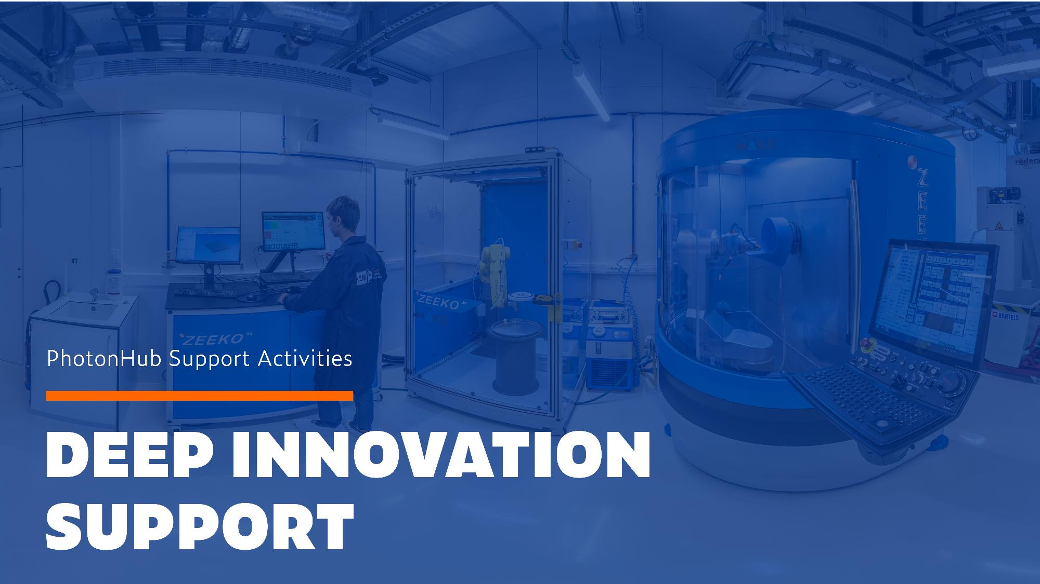
We provide Accelerating Technology Innovation Support
for companies from Prototyping to Upscaling and Manufacturing
Prototyping through Innovation Projects TRL3-4
Upscaling involving EU Pilot-Line Facilities TRL5-6
Manufacturing in Europe TRL7-8 through Brokerage
Notes:
One of the most important tasks of PhotonHub Europe is to provide photonics technology innovation support for companies to accelerate their product innovation process. This happens through innovation projects at the prototyping level, by providing access to pilot-line facilities for product upscaling, and through brokerage for manufacturing in Europe. Important to know is that all these services will be financially heavily supported by the PhotonHub initiative.

Slide 17
First-Level Investment-Readiness Coaching for Companies Deploying Photonics Technologies
Intensive Investor Pitching and Matchmaking Support for High-Potential Start-Ups and Scale Ups
“European Photonics Venture Forum” for photonics start-ups and scale-ups
“Investor Days” for photonics-enabled start-ups and scale-ups
Notes:
Additionally we provide companies with first-level investment coaching for deploying photonics technologies, and we support them with intensive investment pitching coaching and matchmaking at our European Photonics Venture Forums and Investor days.

Slide 18
We Create New Local Photonics Innovation Hubs Covering Most Regions of Europe
We Connect the PhotonHub Network with complementary DIHs
Notes:
Finally we are open to working with regions to set up new local photonics innovation hubs to cover most regions of Europe and to connect our PhotonHub Network with European Digital Innovation Hubs that focus on complementary key digital technologies or industry sectors.

Slide 19
Notes:
PhotonHub supports European companies with photonics innovation, driven by the business need of these companies. In case the best photonics support can be found locally then these innovation projects will have to be funded by local or regional support mechanisms. However in case the best innovation support is to be found cross-border the project can be financially supported by PhotonHub. PhotonHub can also support first time users of photonics with cascading funding in case they want to access pilot line facilities for product upscaling.

Slide 20
Notes:
With its programme PhotonHub Europe Is targeting a considerable economic impact by first raising awareness of the potential of photonics innovation with more than 100.000 European companies 5000 of whom will consecutively visit its demo and experience centers. What is more, PhotonHub expects, as a direct result of its innovation support, to create 740 million euros of new company revenues and 92 million euros of new venture capital raised by EU start ups.

Slide 21
Notes:
90% of the companies that will receive expert support are expected to be SMEs. PhotonHub anticipates to support the creation of 170 new photonics-enhanced product slinked to its innovation support, resulting in 100 million euros of new business for EU photonics manufacturers, 36 million euros of new growth capital, and more than 1000 new high-tech jobs.

Slide 22
Notes:
Furthermore PhotonHUb expects the creation of 5 new local photonics innovation hubs across the European regions.
Finally PhotonHub Europe targets the establishment of the PhotonHub Europe Association by 2024 to continue the photonics innovation support offerings in a durable and self-sustainable way.

Slide 23
PHOTONHUB.EU

